Slide 1

Notes:
Vizibid will revolutionize the way lawyers find and prepare legal documents.

Slide 2
the problem
Notes:
In their daily law practices, lawyers regularly prepare legal documents, using model documents as a starting point for the polished legal documents they draft. Lawyers in large law firms generally have access to an in-house database of model documents.
On the other hand, lawyers who are not in large firms do not have the time or resources to maintain large databases of model documents. These lawyers practice alone (solo), in small firms, and as in-house counsel for small and medium companies. They regularly turn to a variety of expensive, time-consuming, and unreliable sources of model legal documents.
In this respect, solo, small firm, and in-house lawyers have an enormous unmet need.

Slide 3
existing workarounds
(a.k.a. “competition”)
Notes:
This list summarizes the existing methods that solo, small firm, and in-house lawyers use to obtain new model legal documents:
Westlaw. Some lawyers pay excessive subscription fees to access relatively static databases of legal documents on Westlaw (westlaw.com). A subscription to Westlaw’s legal form-finding service, for example, costs about $150 per month, per lawyer, with a minimum two-year contract. While some lawyers can afford such a large financial commitment, many cannot.
Form Books. Some lawyers rely on printed books of forms which cost anywhere from $150 to $1,000 per volume, some of which are available in law libraries. Like the model legal documents on Westlaw, the documents in printed form books quickly go out of date.
Drafting from Scratch. Some lawyers actually draft legal documents from scratch, especially when they cannot find a model document to use as a starting point. Drafting from scratch is time-consuming and creates high costs that the lawyers have to justify to their clients.
Google. Lawyers sometimes search for the documents they want on Google which can occasionally yield a helpful result, but not always.
Pay-Per-Download Sites. Desperate lawyers will pay to download documents one-at-a-time, sight unseen, from websites that sell documents directly to lay consumers, such as nolo.com and uslegalforms.com. Sites like those are known for providing low-quality documents that are overpriced, and there is no way for lawyers to assess the quality of the documents on these websites until their prices have been paid.
Ask a Colleague. Lawyers also frequently ask their colleagues for model documents, which works very well as long as the colleagues actually have what the lawyers need. Lawyers’ email list serves are abuzz across the nation with requests for model documents from solo and small firm lawyers.

Slide 4
the solution
Notes:
Vizibid is a website (vizibid.com) that enables lawyers to find, request, and share model legal documents with other lawyers. Vizibid also enables lawyers to rate documents, write shared comments about the documents, and share revised versions of the documents. By collecting the documents, ratings, and comments that lawyers share with each other, Vizibid will have the world’s first database of peer-generated model legal documents that is available to all lawyers. Vizibid will also have the fastest-growing database of lawyer-approved model legal documents in the world. Lawyers will quickly come to depend upon Vizibid every time they need a new model legal document for their practice.
Vizibid competes with each of the previously mentioned (see slide 3) methods of obtaining model legal documents by some combination of better pricing, higher document quality, and less effort required from the user. A Vizibid subscription will be priced well below the price of a Westlaw subscription or the cost of printed form books. For the cost of a Vizibid subscription, lawyers will gain 24-hour access to an ever-growing database of peer-generated and lawyer-approved model legal documents.
This is a value proposition that no other company or service has ever offered to solo and small firm lawyers.

Slide 5
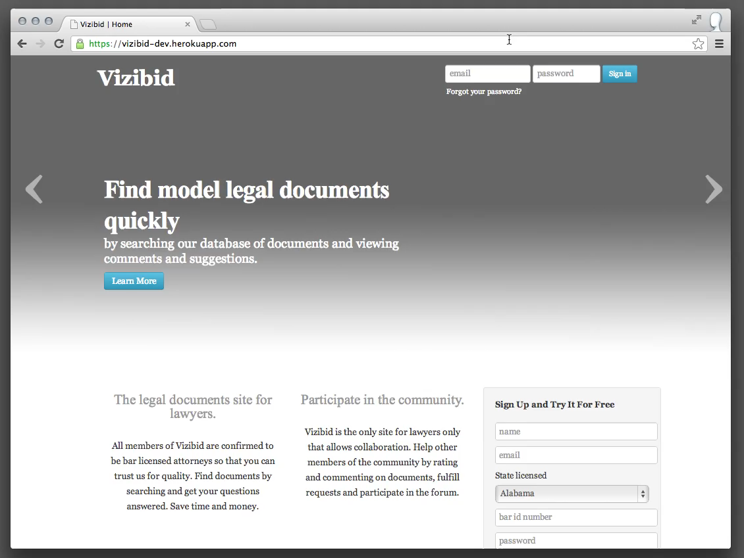
Notes:
[This slide is a screen cast. Click (or double-click) the image to watch the scenario unfold.]
In this screen cast, the user wants to find an LLC operating agreement for Washington State. He searches the site and gets results. He then makes his search more specific and looks at the details page for the document. He likes what he sees so he downloads the document.

Slide 6
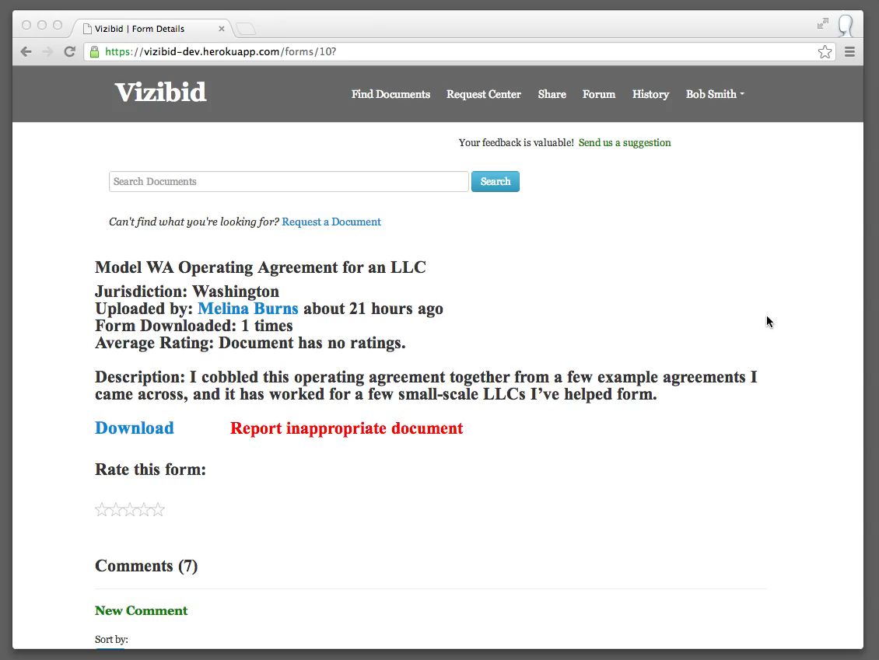
Notes:
[This slide is a screen cast. Click (or double-click) the image to watch the scenario unfold.]
Here the user found the document useful. He signs-in to Vizibid and then up-votes an existing comment, adds a comment, and gives the form a rating.

Slide 7
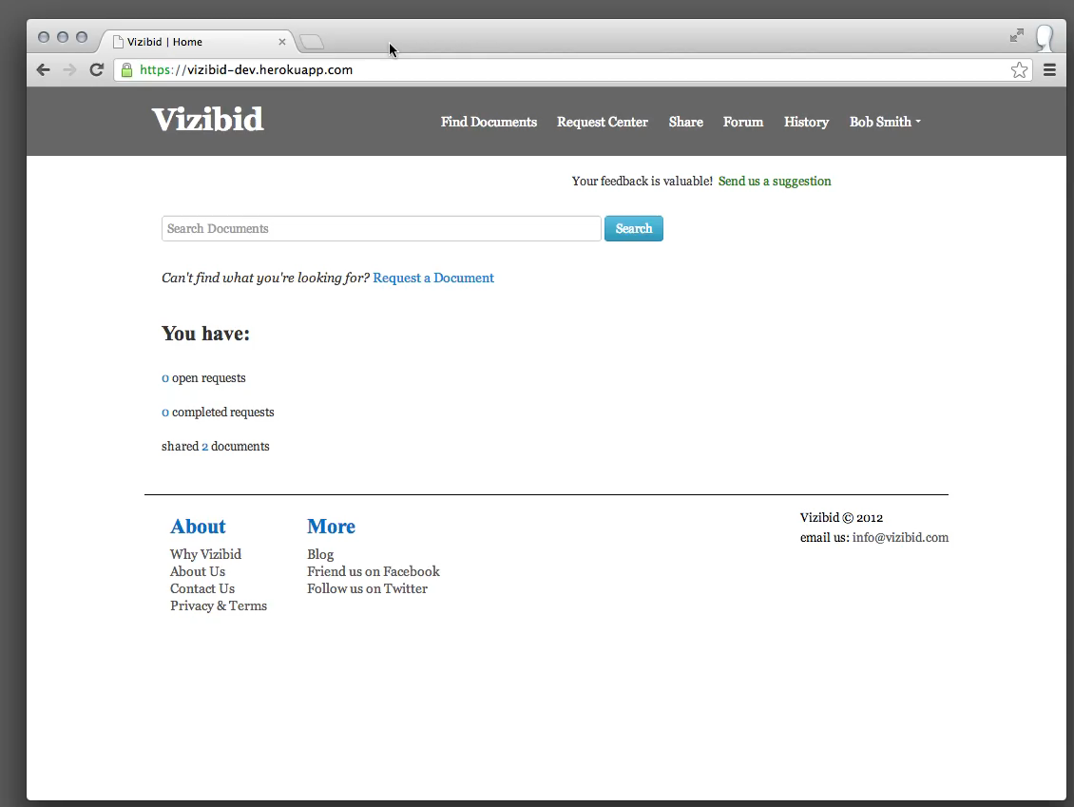
Notes:
[This slide is a screen cast. Click (or double-click) the image to watch the scenario unfold.]
Here the user searches for a document. He doesn’t find what he’s looking for so he puts in a request for the document.

Slide 8
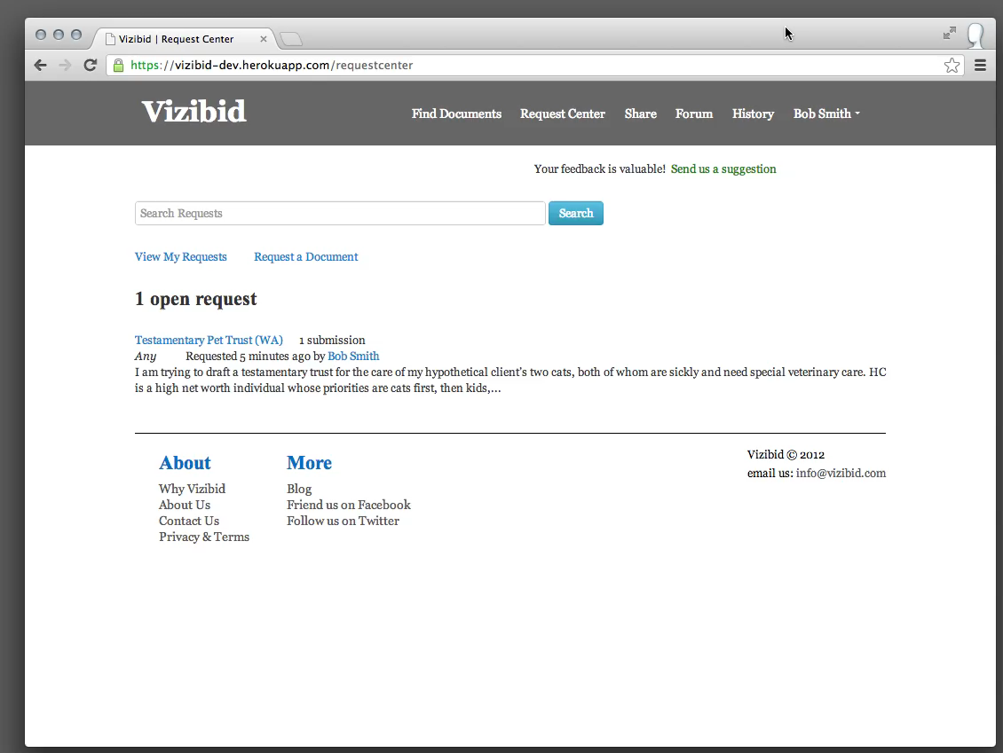
Notes:
[This slide is a screen cast. Click (or double-click) the image to watch the scenario unfold.]
Eventually the user receives email indicating that his request got a response. He checks the response and marks his request as completed since he got what he needed.

Slide 9
customer validation
Notes:
We have validated the willingness of solo, small firm, and in-house lawyers to become paying users of the Vizibid service by conducting (and continuing to conduct) interviews with lawyers from various age groups and practice areas in Washington State. One after another, these potential customers have expressed giddy excitement about using the Vizibid service.
Lawyers we have interviewed have said:
Vizibid is “a needed service,” “a very good idea,” and “a great idea.”
“Solos should have access to a database of high quality model legal documents just like big firm lawyers do.”
The Vizibid service “is something that someone is going to build, whether you do it or someone else does.”
These lawyers have nearly unanimously expressed their willingness to pay for Vizibid subscriptions, stating that they would expect to pay anywhere from $20 to $100 or more per month. In general, these lawyers have stated that they will be very willing to upload their documents to share with other lawyers. So far, each of these lawyers has also requested an invitation to join the service once Vizibid launches. As the momentum picks up, the need for fundraising to harness the momentum is growing.

Slide 10
total addressable market:
more than 350,000 lawyers
Notes:
In the United States there are more than 350,000 lawyers who practice alone or in small law firms. A smaller yet significant number of lawyers work in-house at small and medium companies. This a conservative estimate of the total addressable market in the United States.
The 350,000 figure is based on the following data:
The American Bar Association (ABA) reports a total of 1,225,452 licensed attorneys in the United States as of April 2011. According to the ABA, the percentage of all licensed attorneys in private practice was 73% in 1991 and 74% in 2000; of those lawyers in private practice, 74% were in solo firms or firms with 20 lawyers or fewer in 1991, and 76% in 2000. Assuming the average of these percentages held true in April 2011, the ABA’s figures show that there were approximately 675,530 solo and small firm lawyers in the United States at that time. (See http://www.americanbar.org/content/dam/aba/migrated/marketresearch/PublicDocuments/lawyer_demographics_2011.authcheckdam.pdf.) Other sources suggest this number is lower. For example, the U.S. Bureau of Labor Statistics’ Occupational Outlook Handbook puts the total number of lawyer jobs in the U.S. at 728,200 in 2010. (See http://www.bls.gov/ooh/legal/lawyers.htm.) The National Association of Law Placement reported in its August 2011 NALP Bulletin that 52.6% of male lawyers and 49.5% of female lawyers were in solo practice or firms with 25 lawyers or fewer in 2010. (See http://www.nalp.org/employmentpatterns1999-2010.) With these figures in mind, our estimate of 350,000 lawyers in solo or small practice firms is on the conservative end of the spectrum of available figures.

Slide 11
customer acquisition
Notes:
We intend to market Vizibid’s services through ad placement in a variety of existing channels. These include search engine marketing and placing ads in regularly disseminated print and web publications directed to lawyers, such as the very common monthly magazines printed by bar associations and hundreds of other lawyer organizations. We will also foster relationships with individuals who have already voluntarily adopted roles in educating lawyers on the various software tools available to improve the practice of law in solo law offices and small firms. These individuals include bar association employees, law school professors and employees, and leaders of legal organizations. We will also offer incentives to converted users for referring new users to Vizibid. We intend to offer new users a free 30-day subscription to encourage user acquisitions.

Slide 12
launch strategy
Notes:
Our go to market strategy involves a “soft launch” of the Vizibid service to a targeted set of early adopters in Washington State. The soft launch will be a limited-time free offering of the Vizibid service to the early adopters during which we will test and validate the following: (1) the best methods for incentivizing users to actively participate in uploading model legal documents; and (2) the acceptable price point for Vizibid subscriptions. We will also use the soft launch as an opportunity to get broad feedback about the service from early adopters to help us deliver the best possible experience when the service launches broadly.
Once we meet these goals, Vizibid will launch broadly and scale up as quickly as possible. As a peer-to-peer service with user-generated content, the more users Vizibid has, the greater value Vizibid will provide to each user. In part because of this, we anticipate that Vizibid’s user acquisition rate will accelerate rapidly after the broad launch.

Slide 13
$20-50 per month, per user
Notes:
We anticipate that a standard Vizibid subscription will be priced somewhere in the range of $20 to $50 per month, per lawyer. Vizibid is able to offer its service at this highly competitive rate because of the low overhead associated with operating a web service when the content is primarily user-generated.

Slide 14
up-sell opportunities
Notes:
We anticipate being able to offer Vizibid’s users a variety of additional account features in exchange for higher/additional subscription rates. A couple of examples of these up-sell opportunities include offering: (1) subordinate user accounts for a lawyer’s paralegals and legal assistants; and (2) discounts for bulk subscriptions (to encourage every lawyer in the firm to sign up).

Slide 15
growth into large law firms
Notes:
We expect demand from lawyers in larger law firms once the product becomes established with solo and small firms in the U.S. market. Lawyers in larger firms will find that Vizibid has a larger and more up-to-date collection of model documents than what their firms can maintain internally. We will also be able to privately host a firm’s collection of model legal documents, which will provide Vizibid’s commenting, ratings, and search features around the firm’s private documents.

Slide 16
international and other professions
Notes:
We expect to be able to expand the Vizibid service internationally after becoming established in the U.S. market. We are considering also expanding the service into other professions beyond lawyers if we discover an appropriate opportunity.

Slide 17
financial projections
Notes:
We have developed a five-year projection that assumes an initial funding of $500,000 with a follow-on round of $500,000 after one year, a $25 per month subscription cost, and that we are able to capture approximately 10% of the addressable market within three years, then increase to 20% of the addressable market in the following two years.
Based on this model, we expect pre-tax profits of $2.9 million at the end of year 3, $10.9 million by the end of year 4 and $15.6 million by the end of year 5.

Slide 18
$530,000
Notes:
We are raising $530,000. The capital will be used to finish the initial development of the Vizibid service and perform the soft launch. We will require a follow-on round of at least another $500,000 after one year to support rapidly scaling the user base. Our financial projection models, including a breakdown of our anticipated revenue and expenses, is available to interested investors upon request.

Slide 19
founders: Forrest Carlson and Marc Beitchman
Notes:
Vizibid was cofounded by Marc Beitchman and Forrest Carlson. Marc Beitchman is a professional software engineer at Microsoft with diverse development experience ranging from low-level computer architecture and compilers to application platforms and web services. At Vizibid, Marc is in charge of product and business strategy development. Marc will finish his master’s degree in computer science and engineering from the University of Washington in June of this year. He received his bachelor’s degree in computer science and music engineering from the University of Miami.
Forrest Carlson is a lawyer with a solo law practice in Seattle, Washington. As a practicing lawyer, he is intimately aware of lawyers’ day-to-day operational needs. Forrest is excited about the many emerging possibilities in the realm of service technologies for lawyers, especially those that improve the experience of the practice of law while improving access to the justice system for people of all income levels. Vizibid is part of Forrest’s vision for improvements to the legal profession through a more complete expression of the collective intelligence, training, and good will of lawyers. At Vizibid, Forrest drives the development of the customer experience, product design, and company vision. Forrest received his JD from Seattle University School of Law and his bachelor’s degree from Seattle University.

Slide 20
questions

